Slide 1
19Z502 Microprocessors and Interfacing
Hardware Architecture
Dr.N.Arulanand
CSE, PSG CT

Slide 2
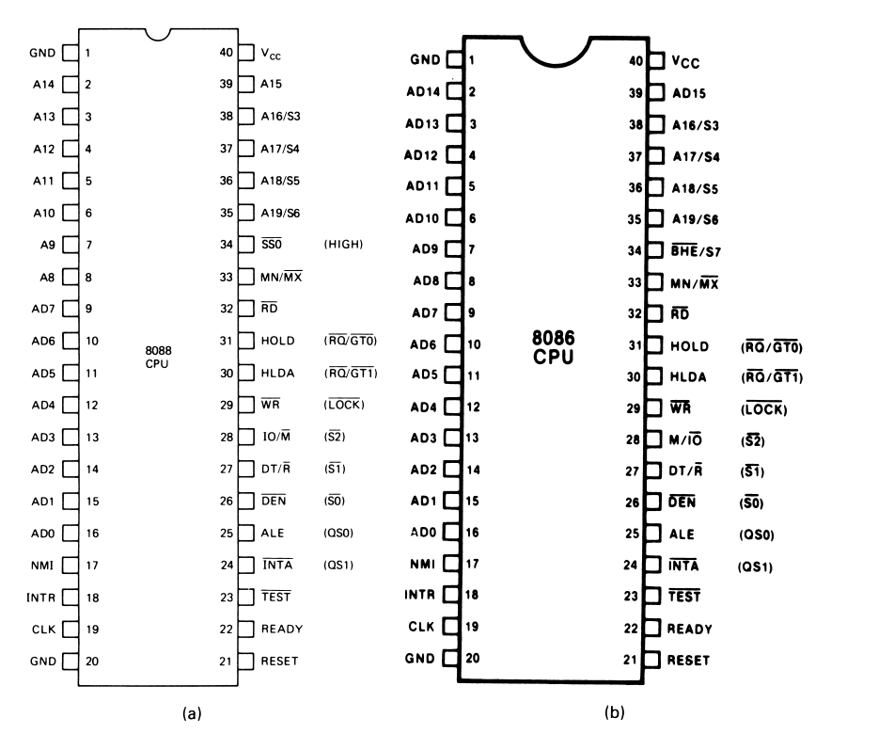

Slide 3
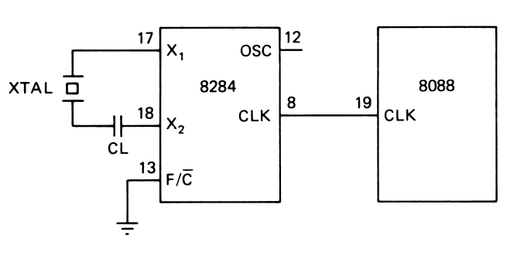
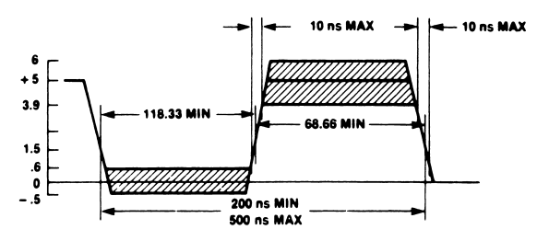
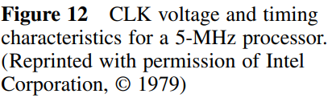
System Clock
The fundamental crystal frequency is divided by 3 within the 8284 to give either a 5- or 8-MHz clock signal
The standard way in which this clock chip is used with the 8088 is to connect either a 15- or 24-MHz crystal between its X1 and X2 inputs

Slide 4
Question ?
If the CLK input of an 8086 MPU is to be driven by a 9-MHz signal, what speed version of the 8086 must be used and what frequency crystal must be attached to the 8284?

Slide 5
8088 and 8086 speed variants
A clock cycle, also known as a machine cycle or a clock tick, is the basic unit of time in a computer's central processing unit (CPU)
8088
5 MHz and 8 MHz
What is the clock period of 8 MHz ?
8086
5 MHz, 8 MHz and 10 MHz

Slide 6
Bus Cycle and Timing States
The 8086/8088 microprocessors use the memory and I/O in periods called bus cycles. A bus cycle defines the basic operation that a microprocessor performs to communicate with external devices
Each bus cycle equals four system-clocking periods (T states).
If the clock is operated at 5 MHz (the basic operating frequency for these two microprocessors), one 8086/8088 bus cycle is complete in 800 ns.
This means that the microprocessor reads or writes data between itself and memory or I/O at a maximum rate of 1.25 million times a second.
Because of the internal queue, the 8086/8088 can execute 2.5 million instructions per second [MIPS] in bursts.
Newer microprocessors divide the bus cycle into as few as two clocking periods.

Slide 7
Bus Cycle with no wait states
The bus cycle of the 8088 and 8086 microprocessors consists of at least four clock periods. These four time states are called T1, T2, T3, and T4.
During T1, the MPU puts an address on the bus.
For a write memory cycle, data are put on the bus during state T2 and maintained through T3 and T4.
When a read cycle is to be performed, the bus is first put in the high-Z state during T2 and then the data to be read must be available on the bus during T3 and T4.
These four clock states give a bus cycle duration of 125 ns * 4 = 500 ns in an 8-MHz 8088 system.

Slide 8
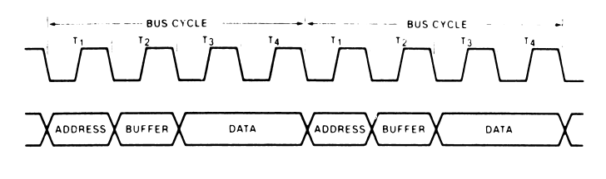
Bus Cycle - example

Slide 9
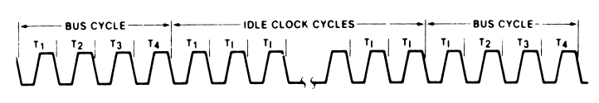
Idle State
If no bus cycles are required, the microprocessor performs what are known as idle states. During these states, no bus activity takes place. Each idle state is one clock period long, and any number of them can be inserted between bus cycles.
Idle states are performed if the instruction queue inside the microprocessor is full and it does not need to read or write operands from memory

Slide 10
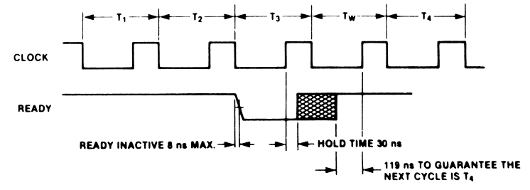
Wait State
Wait states can also be inserted into a bus cycle. This is done in response to a request by an event in external hardware
This extends the duration of the bus cycle, thereby permitting the use of slower memory and I/O devices in the system.

Slide 11
Question ?
What is the duration of the bus cycle in the 8088-based microcomputer if the clock is 8 MHz and two wait states are inserted?

Slide 12
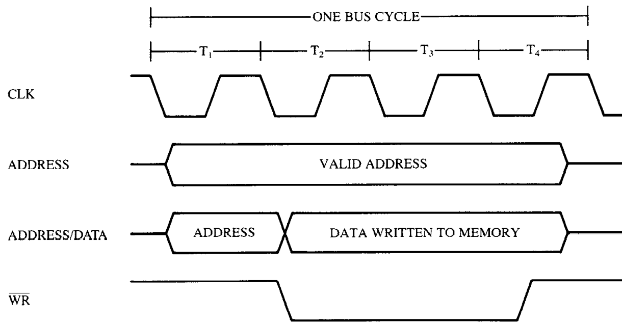
Simplified 8086/8088 Write Bus Cycle

Slide 13
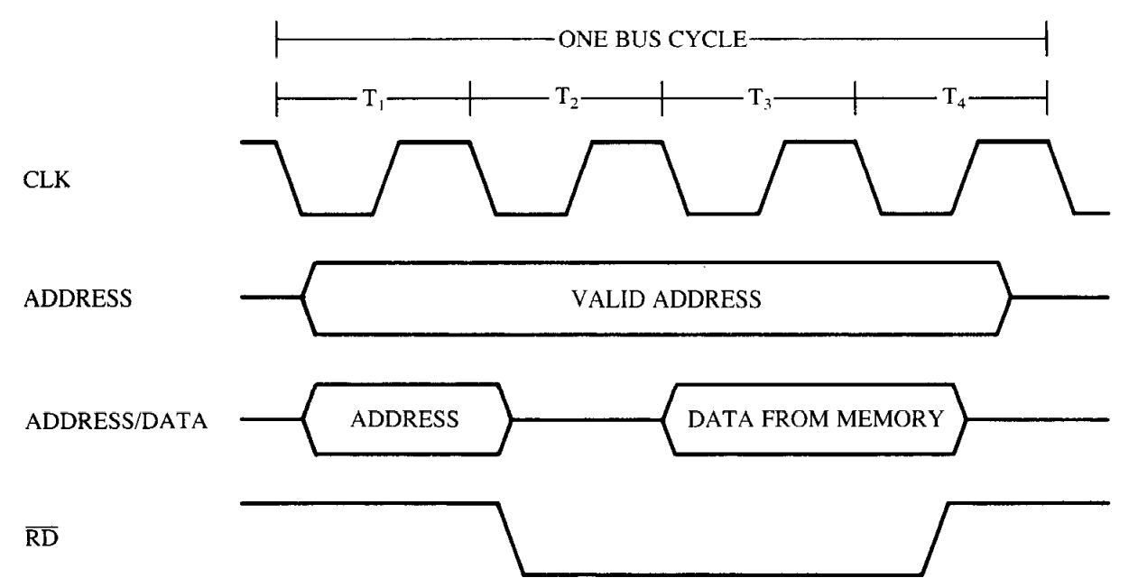
Simplified Read Cycle

Slide 14
Timing in General
T1 state: During the first clocking period in a bus cycle, the address of the memory or I/O location is sent out via the address bus and the address/data bus connections. (The address/data bus is multiplexed and sometimes contains memory-addressing information, sometimes data.) During TI, control signals ALE, ,DT/R’ and (8088) or (8086) are also output. The IO/M’ or M/IO’ signal indicates whether the address bus contains a memory address or an I/O device (port) number
T2 state: the 8086/8088 microprocessors issue the RD’ or WR’ signal, DEN’, and in the case of a write, the data to be written appear on the data bus. These events cause the memory or I/O device to begin to perform a read or a write.
T3 state: This clocking period is provided to allow the memory, time to access data. If the bus cycle happens to be a read bus cycle, the data bus is sampled at the end of T3. READY is sampled at the end of T2, If READY is low at this time, T3 becomes a wait state (Tw).
T4 state: All bus signals are deactivated in preparation for the next bus cycle. This is also the time when the 8086/8088 samples the data bus connections for data that are read from memory or I/O. In addition, at this point, the trailing edge of the signal transfers data to the memory or I/O, which activates and writes when the signal returns to a logic 1 level

Slide 15
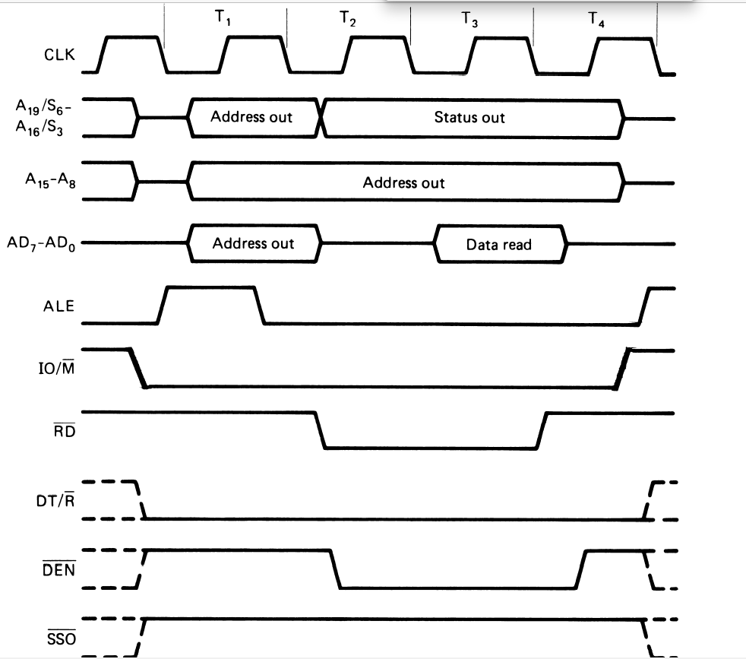
8088 Read Cycle

Slide 16
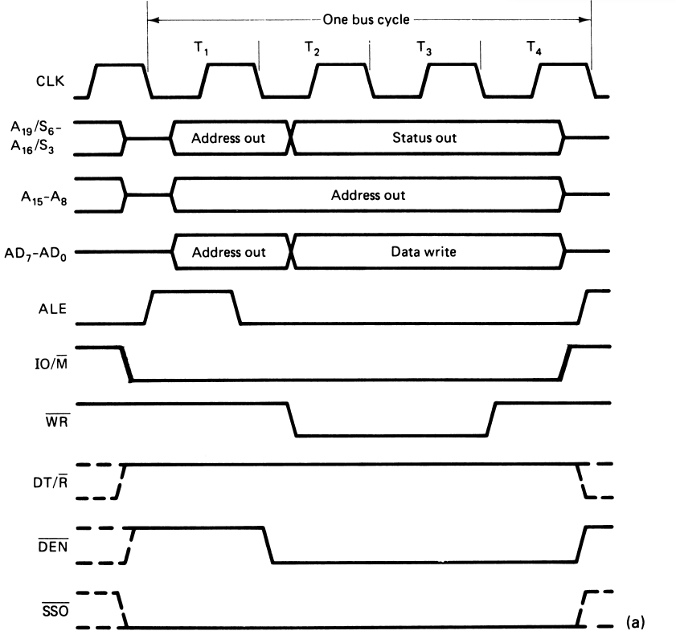
8088 Write Cycle

Slide 17
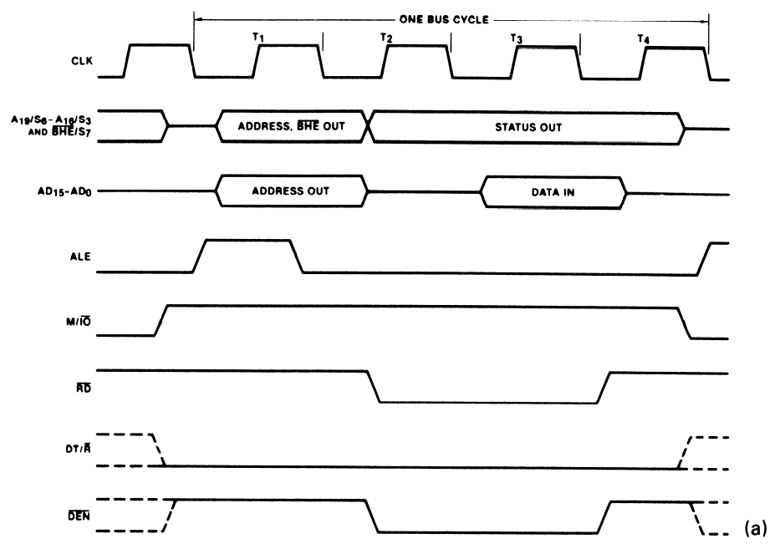
8086 – Minimum Mode Read Cycle

Slide 18
Difference between 8088 and 8086 bus cycles
The write cycle of the 8086 differs from that of the 8088 in four ways;
SSO’ is not produced;
BHE’ is output along with the address;
data are carried over all 16 data bus lines; and finally,
M/IO’ is the complement of the 8088’s IO/M’ signal.

Slide 19
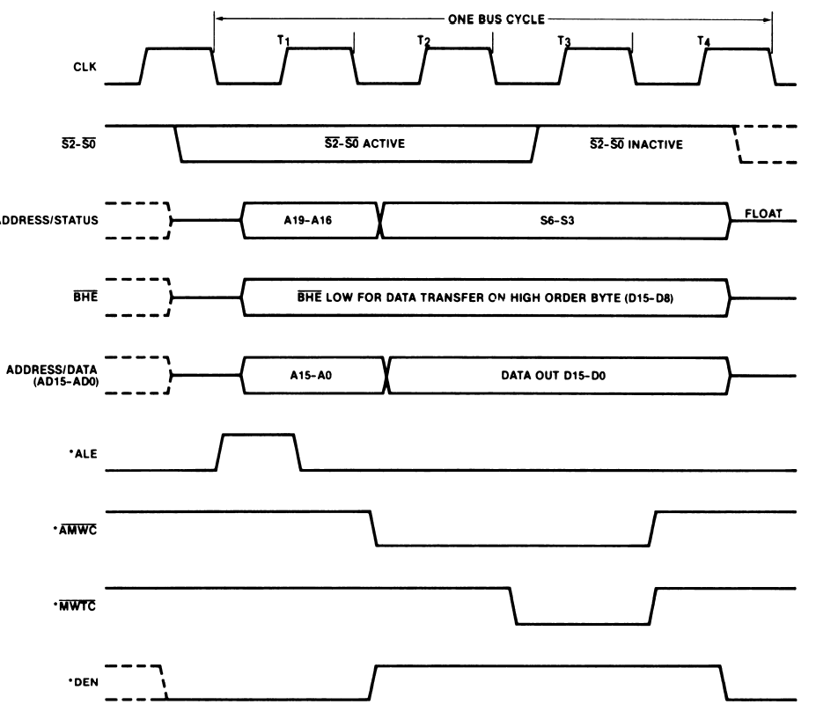
8086 Write Cycle

Slide 20
Idle and Wait State
If no bus cycles are required, the microprocessor performs what are known as idle states. During these states, no bus activity takes place. Each idle state is one clock period long, and any number of them can be inserted between bus cycles.
Idle states are performed if the instruction queue inside the microprocessor is full and it does not need to read or write operands from memory.
Wait states can also be inserted into a bus cycle. This is done in response to a request by an event in external hardware

Slide 21
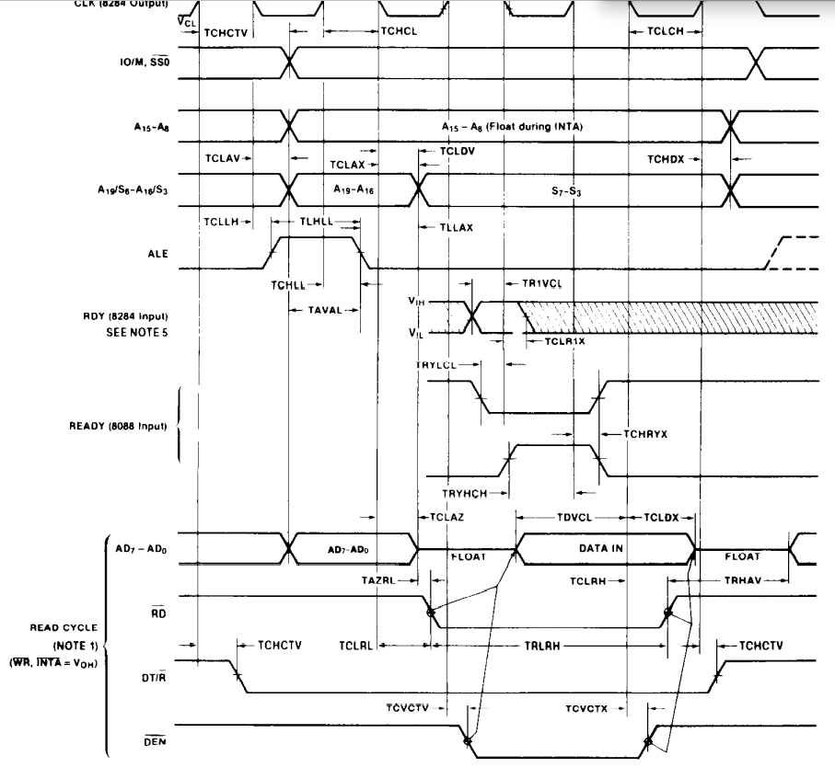
8088 Read cycle

